Slide 1
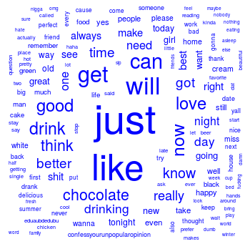

What about proportional similarities?
The problem is that if corpusA has 1 instance & corpus has 1000 they appear as shared.

Slide 2
Let’s make some pyramids

Slide 3
Steps for a pyramid plot…collapse
Combined/Collapsed
into a 2 document corpus
CorpusA – 1000 Tweets
Clean & Collapse
CorpusB – 1000 Tweets
Clean & Collapse

Slide 4
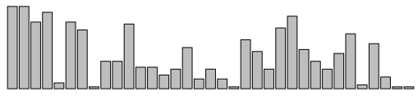
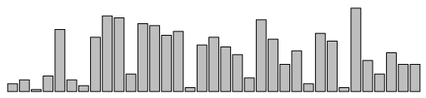
Steps for a pyramid plot…ID common tokens & frequency

Slide 5
Build a “pyramid plot” of frequencies
termA
termB
…
TermN

Slide 6

Open ﻿K_Pyramid_plots.R

